Slide 1
McKinney-Vento for JJAG
Amelia Lyons Rukema
Homeless Education State Coordinator
Amelia.lyons@maine.gov

Slide 2





McKinney-Vento Homeless Assistance Act
What is this?
I’m a pro
Notes:
poll

Slide 3

McKinney-Vento Homeless Assistance Act
The McKinney-Vento Homeless Assistance Act was the first -- and remains the only - - major federal legislative response to homelessness
First passed in 1987, multiple amendments and reauthorizations
Notes:
housing is the fundamental solution to homelessness
And we are one piece of the puzzle
How to keep kids in school when their housing situation is not permanent?
With the death of Stewart McKinney, its chief sponsor, it was renamed Stewart B. McKinney Homeless Assistance Act. After the death of a leading supporter of the legislation, Bruce Vento, President William Clinton renamed it the McKinney-Vento Homeless Assistance Act.

Slide 4
State Homeless Education Coordinator
Every state has a State Coordinator who supports local liaisons with
  technical assistance about State and Federal policies
  provide funding to districts
  Professional development
  Maine DOE’s website for Homeless Education can be found here

Slide 5

First Story
This Photo by Unknown Author is licensed under CC BY-ND
Notes:
The first is a true story about a high school student, Brittany, who comes to enroll in Camden from a nearby district Belfast (30 mins), hasn’t showered, her clothes are wrinkled and she is extremely fatigued.
Her attendance declines. Voicemails, texts, letters home, no communication. The school resource officer tries to do a home visit, to no avail. You hear the student is pregnant and has withdrawn from school.
Fast forward years later and
She eventually finds safe housing and gets her high school equivalency through her adult education center. She is a proud mother. She now serves on the Maine Youth Action Board advising homeless programs statewide, including McKinney-Vento, so that other students don’t end up in her situation again. The YAB’s work encourages us to work together to raise awareness about this critical program and embrace the opportunity to better identify and serve all McKinney-Vento students and get them to graduation!

Slide 6
Second Story
Notes:
The second is a story about what else could have happened.
Same story. High schooler comes to enroll, hasn’t showered, wrinkled clothes, and she is very tired. In this version, she completes the McKinney-Vento Screener form in her enrollment packet. She says she’s staying with friends temporarily.

Slide 7
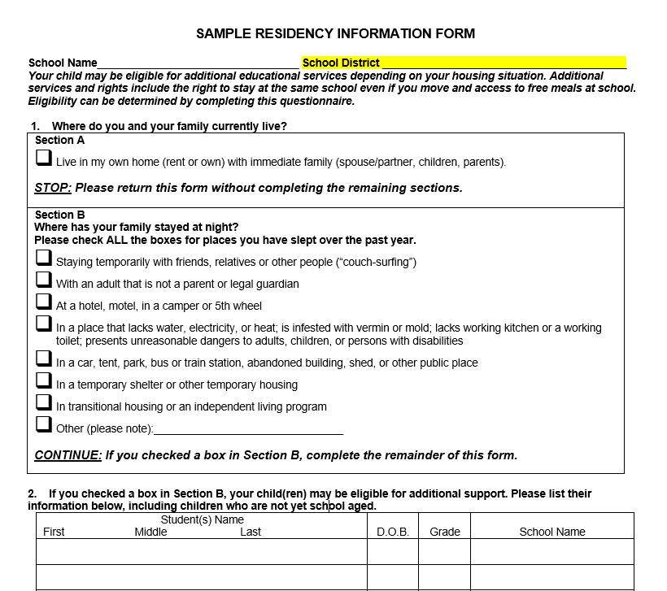
McKinney-Vento Screener Form
Notes:
Is this form in our back to school paperwork? Raise your hand if it is.
New enrollment paperwork?
Online enrollment?
Do we send reminders about this program on our social media, parent newsletters, etc?

Slide 8















Second Story
Notes:
The local district McKinney-Vento liaison shares with the student about her rights under McKinney-Vento. First, that she has a right to remain in her same school and receive transportation, or to immediately enroll in the new school, even if she doesn’t have the records normally required for enrollment.
The young person wants to stay in their same school so she gets support with a ride to and from school, a cell phone, free meals, health services, mental health support, tutoring, school supplies. She takes showers at school and stores her belongings in extra lockers on campus. Afterschool she uses the laundry facilities on site. She continues on to graduation!

Slide 9

“I wish my teachers knew that my mom was doing the best she could. She was working three jobs and we still didn’t have a stable place to live.”
– Maine Youth Action Board Member

Slide 10
How vulnerable are you to becoming homeless?
Answer “yes” or “no” to the following:
Could you experience a flood, fire, tornado, or other natural disaster?
Do you live in a place where your home’s pipes could freeze and burst?
Do you work in an area of the economy/job market where your job might become obsolete?
Could you suffer from a long-term illness or accident without proper health benefits or other compensations?
Are housing costs in your area increasing faster than wages?
Does anyone in your family struggle with addictions such as drugs or alcohol?
Do you live in a household with only one full-time wage earner?
Are you behind in any monthly bills?
Adapted from Helping H.A.N.D.S., Paducah, NY

Slide 11

Change the Narrative
Get the word out about McKinney-Vento!
A resource for everyone in our communities.
Notes:
We all need to know about this program because it could be our family facing these difficult times, or it could be our family who takes in a family or youth facing a lack of housing. The McKinney-Vento program is not a program only for students who qualify for free lunch. It is an essential backbone to our schools and communities that says any of us can come across hard times, and our schools will be there to support our children if and when that happens to the children in our community.

Slide 12
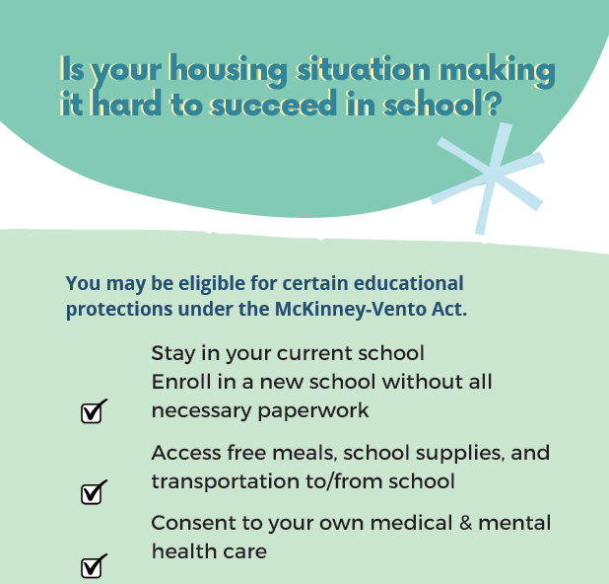

Slide 13
Timeframe
Homelessness must be documented each school year, but a child is eligible for MV services through the academic year, even if they become stably housed part way through the year.
Is there a time limit on how long a child or youth can be considered homeless?
Notes:
No time limit. Could be for many years.

Slide 14

Definition
Homelessness is defined as lacking a fixed, regular, and adequate nighttime residence
This Photo by Unknown Author is licensed under CC BY-ND

Slide 15
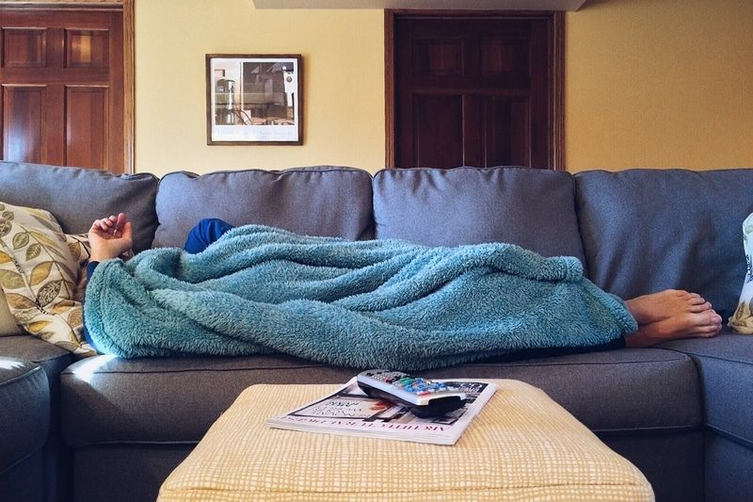
sharing housing due to loss of housing, economic hardship, or a similar reason;
This Photo by Unknown Author is licensed under CC BY-NC-ND
Notes:
Raise your hand if you know of a student who has been in this situation. Does your liaison know them?
Can someone share a de-identified example? What was the situation?
Did the family move in together for mutual benefit or due to a crisis or other precipitating event?
Is there a plan for the household to remain intact over a long term, or is it a short-term situation?
If unable to stay where they are, would the family be in a clearly homeless situation or in another apartment or house?
Does everyone have a bed to sleep in? Is the plumbing and electric service safe? Is the housing otherwise adequate?
Is the family being added to the lease, or have they signed a lease?

Slide 16
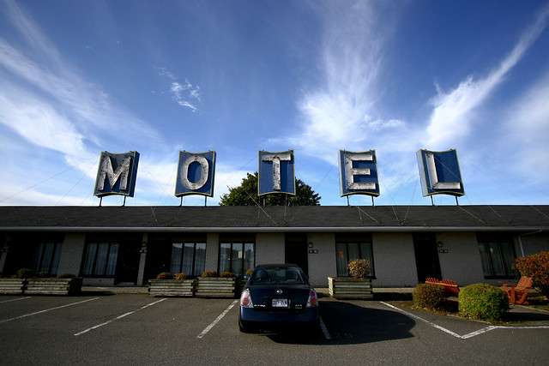
living in hotels, motels, due to lack of adequate housing;
This Photo by Unknown Author is licensed under CC BY-NC
Notes:
Raise your hand if you know of a student who has been in this situation. Does your liaison know them?
Can someone share a de-identified example? What was the situation?

Slide 17
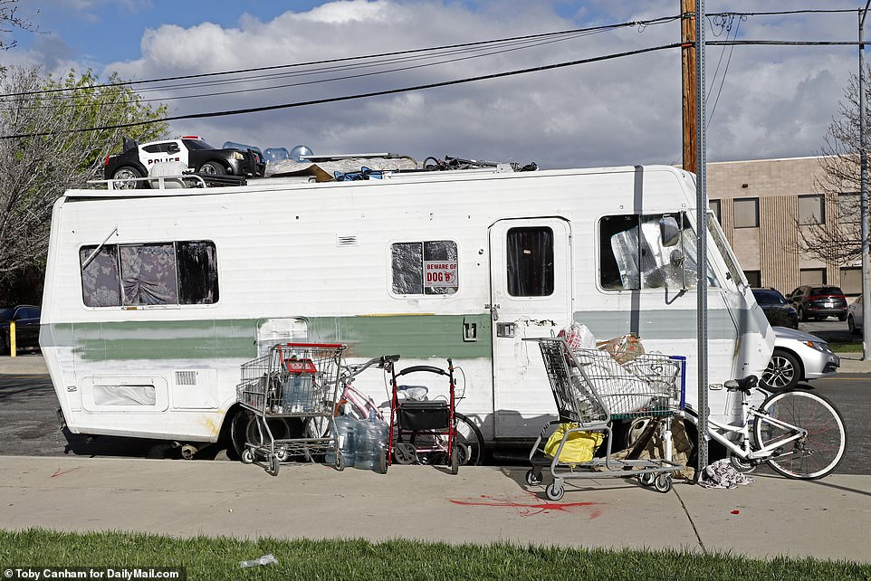
trailers, or camping grounds due to lack of adequate housing;
Notes:
Raise your hand if you know of a student who has been in this situation. Does your liaison know them?
Can someone share a de-identified example? What was the situation?

Slide 18
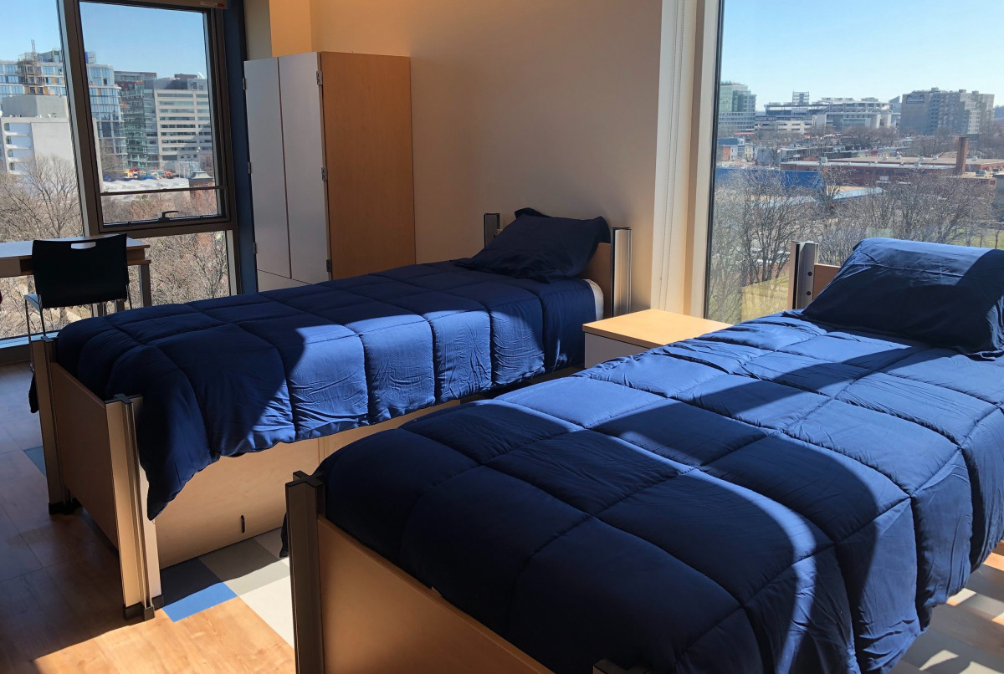
living in emergency or transitional shelters;
This Photo by Unknown Author is licensed under CC BY-NC
Notes:
Raise your hand if you know of a student who has been in this situation. Does your liaison know them?
Can someone share a de-identified example? What was the situation?

Slide 19
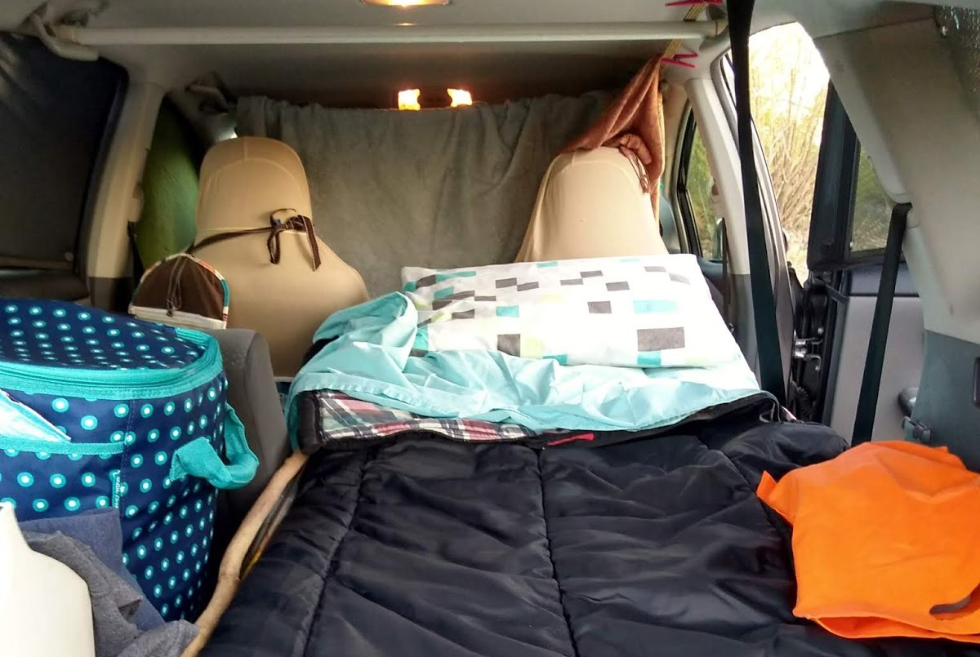
  living in cars,
This Photo by Unknown Author is licensed under CC BY-NC-ND
Notes:
Raise your hand if you know of a student who has been in this situation. Does your liaison know them?
Can someone share a de-identified example? What was the situation?

Slide 20
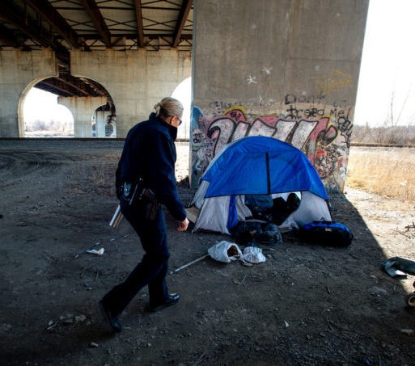
parks, public spaces, abandoned buildings
Notes:
Raise your hand if you know of a student who has been in this situation. Does your liaison know them?
Can someone share a de-identified example? What was the situation?

Slide 21
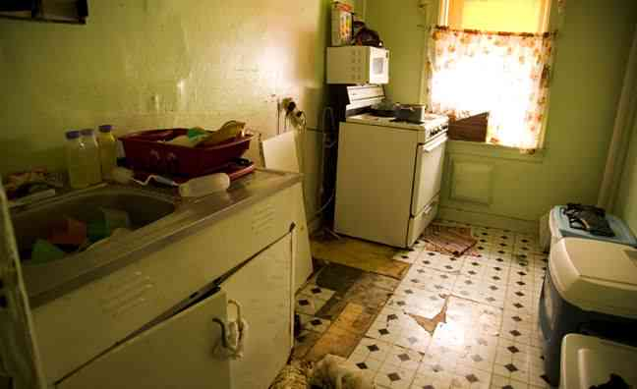
Substandard Housing
Notes:
Raise your hand if you know of a student who has been in this situation. Does your liaison know them?
Can someone share a de-identified example? What was the situation?
What criteria could be used to determine if housing is “substandard”?
the housing lacks one of the fundamental utilities (water, electricity, or heat)
infested with vermin, pests, or mold
lacks a functional part such as a working kitchen or a working toilet
may present unreasonable dangers to adults, children, or persons with disabilities
overcrowding
would not pass local building codes
without adequate heat, electricity, or water;
with unsafe heat sources or electrical service;
with unsafe conditions, such as holes in flooring;
with a kitchen or plumbing that is inoperable; or
condemned by housing or other government authorities.

Slide 22
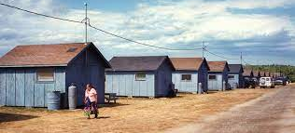
Migratory students living in one of the previously mentioned situations
Notes:
Raise your hand if you know of a student who has been in this situation. Does your liaison know them?
Can someone share a de-identified example? What was the situation?

Slide 23
Can the student go to the…
SAME PLACE (fixed)
EVERY NIGHT (regular) to sleep in a
SAFE AND SUFFICIENT SPACE (adequate)?

Slide 24
What can schools offer?
Free meals
Transportation to school of origin
Immediate enrollment, without required documents
School supplies
Clothing, hygiene items, access to showers, laundry
Support with FAFSA, post secondary
Referrals for health, mental health, housing, other needs
Before/afterschool, summer, mentoring
Tutoring and instructional support
other extraordinary or emergency assistance needed
Early childhood education
Cover fees for accessing records
Notes:
Tutoring
Expedited evaluations
Professional development
Referral services
Transportation
Early childhood education
Services before or afterschool, mentoring, and summer programs
Fees for records
training to parents on rights, PI,
Coordination bw schools and agencies
Instructional support
Activities to address needs of kids from DV, MH, or SUD
Space and school supplies
The provision of other extraordinary or emergency assistance needed to enable homeless children and youths to attend school and participate fully in school activities.

Slide 25
“The key is seeing a robust McKinney-Vento program as a solution to a lot of problems—classroom management problems, discipline problems, and graduation rate problems.”
- Linda Long, Support/Homeless Services Coordinator, KS

Slide 26
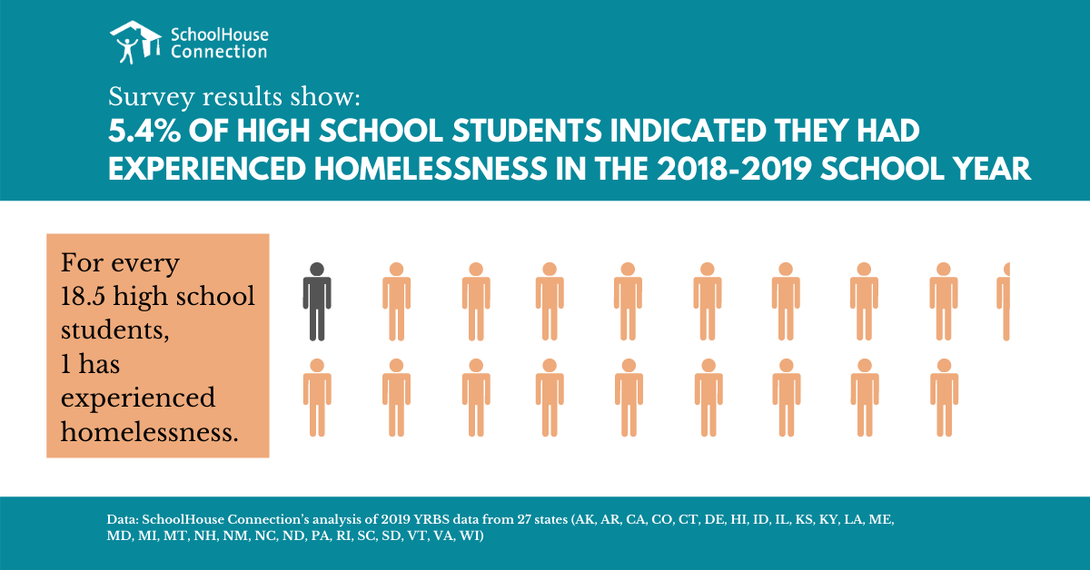

Slide 27
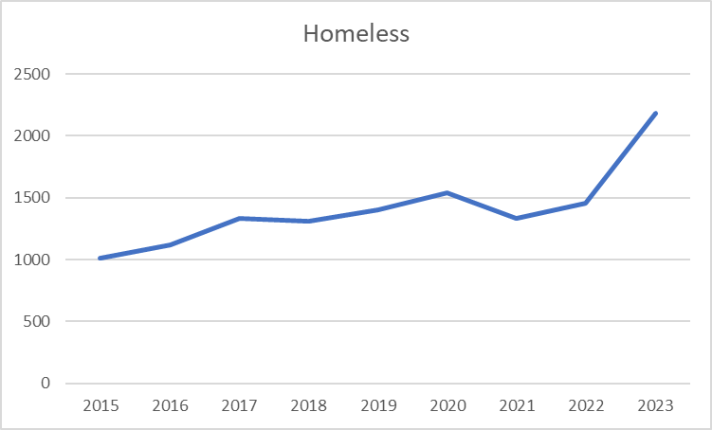
Maine McKinney-Vento Counts by Year

Slide 28
Maine McKinney-Vento by Living Situation

Slide 29
Enrollment of HCY, by grade category: SY 2020-21

Slide 30

Check in
Notes:
Thumb o meter
Let me know what we can do to turn that dial

Slide 31
What to do – look closer
Potential signs of homelessness might include:
Hearing children or parents talking about having to leave where they are staying, or staying with other people
Being in public places during the school day
Unmet hygiene needs
Unmet medical/dental needs
Wearing the same clothes repeatedly
Fatigue
Social and behavioral challenges
Lack of participation in field trips and/or afterschool activities, lack of basic school supplies, inability to complete special projects
Enrollment at multiple schools, lack of records, gaps in learning, poor/inconsistent attendance
If you notice any of these signs, check in with your district liaison

Slide 32
What to do – learn more
Speak with the student/family privately
Connect with them to ask in a caring way
Be conversational so that families do not feel interrogated
Request permission to ask questions
Share your commitment to problem-solving and sharing resources with the family
Avoid unnecessary questions that may cause embarrassment
Explain the reasons for your questions
Show respect by conveying that you see the parents as the experts on their family
Apply active listening skills that demonstrate compassion and respect
Avoid using the word “homeless”

Slide 33
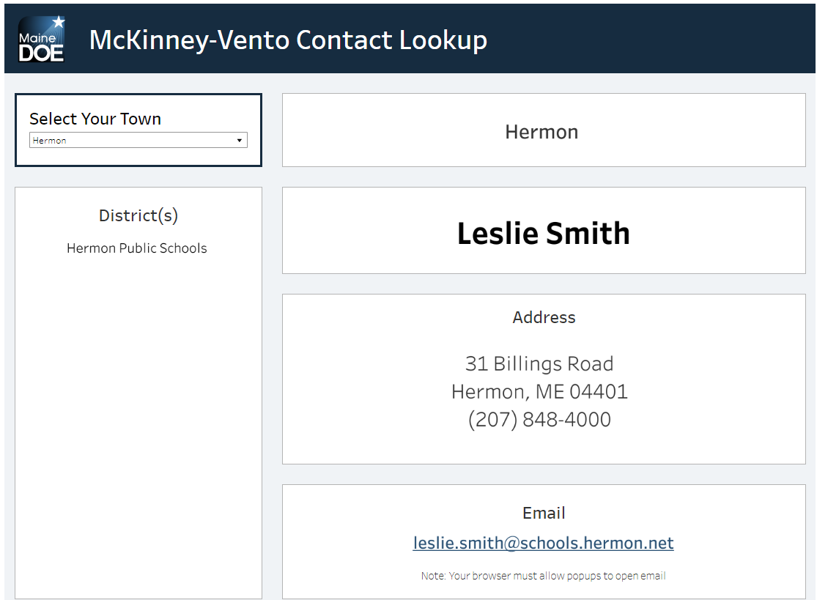
New Liaison Look Up
https://www.maine.gov/doe/schools/safeschools/counseling/highmobility/homelessed/liaisonlookup
Notes:
https://www.maine.gov/doe/schools/safeschools/counseling/highmobility/homelessed/liaisonlookup

Slide 34
“Information is not implementation.”
Zaretta Hammond
#schooltalk 2/3/22
Now, take a moment -
1 word you’re still thinking about
or
1 thing you don’t want to forget a month from now

Slide 35
What is your call to action?
Who is your local liaison? Ask them to train your team!
What families do you know who may qualify?
Post materials in your spaces
How do you build a community of trust?

Slide 36

Looking for more resources?
Find your local school district liaison here: https://www.maine.gov/doe/schools/safeschools/counseling/highmobility/homelessed/liaisonlookup
Or contact amelia.lyons@maine.gov or 207-557-1787
www.maine.gov/doe/schools/safeschools/counseling/highmobility/homelessed

Slide 37
thank you
What questions do you have?

Slide 38


