Slide 1
The Opioid Settlement Funds & JJAG
Liz Blackwell-Moore, MPH
Director, Cumberland County Public Health Department

Slide 2
Purpose:
Provide
High Level introduction to the Maine Recovery Council and local “Subdivision” efforts
Share
Share information about prevention efforts related to the Opioid Settlement Funding
Discuss
Discuss any possible synergies between the efforts of the JJAG and work potentially funded by Opioid Settlement.

Slide 3
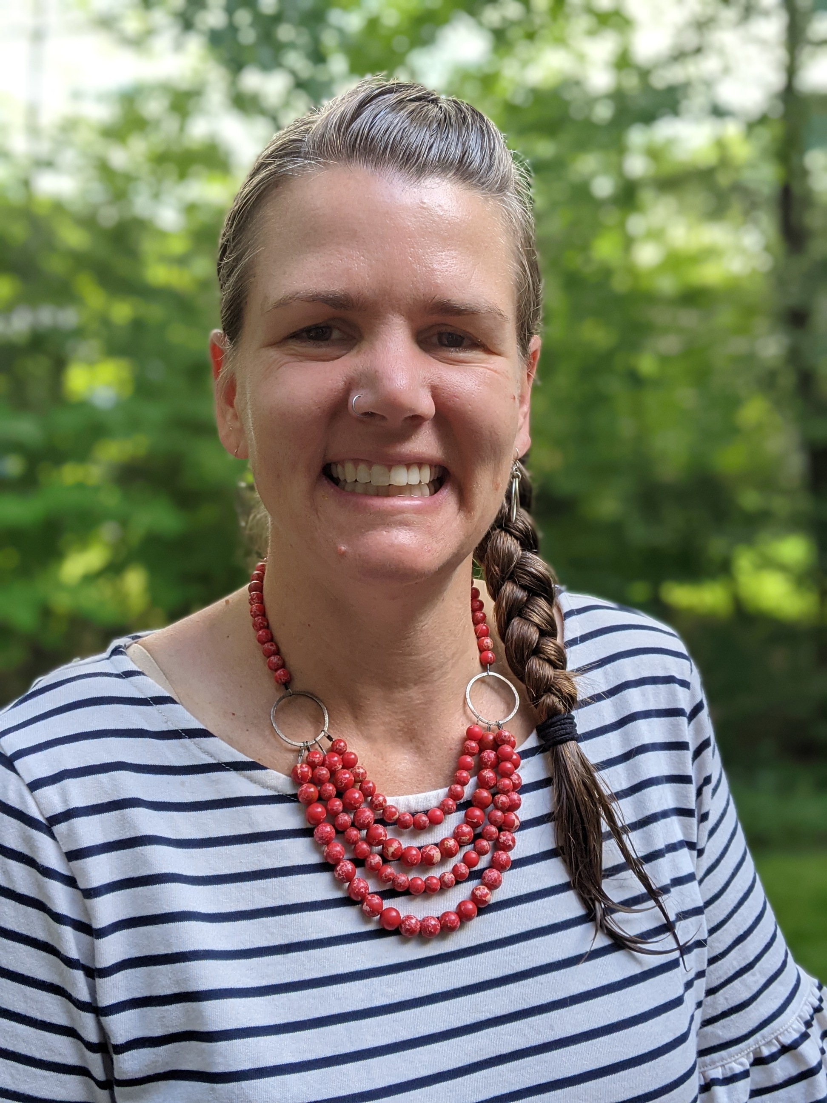
How I come to you today:
Harm Reduction Case Manager
Prevention Specialist
SUD and Public Health Coordination and Evaluation Consultant
Public Health Director- Community Conditions and Systems
Maine Recovery Council Member- Representing the Subdivisions

Slide 4
Total Estimate Funding: as of now, $234M over 17 years
Distribution of Funds:
20% Maine Attorney General
30% Subdivisions (Counties, litigating towns and towns above 10,000 pop.)
50% Maine Recovery Council
Maine Opioid Settlement
Estimated Payment Amounts | In 2023 | Total over 17 years
Attorney General | $5.8M | $47M
Subdivisions | $8.7M | $70M
MRC | $14.5M | $117M
Approved Uses:
Broad list of approved uses for evidenced based or evidenced informed strategies in prevention, harm reduction, treatment, recovery, and other (coordination, leadership, research). Cannot supplant
Maine MOU Regarding Use of Settlement Funds

Slide 5
Cost of the Opioid Epidemic in Maine
CDC tools estimate that the total cost of OUD and opioid overdoses in Maine in 2020 was $8.9B
Direct cost was $380M- Health care, SUD treatment, criminal legal system
Indirect cost was $8.5B -Lost productivity, reduced quality of life, value of statistical life lost
Prevention usually makes up about 1-2% of all direct costs but was not calculated in CDC’s cost estimates
CDC Morbidity and Mortality Weekly Report, 2021
Joint Economic Committee Democrats, 2022

Slide 6
Maine Recovery Council- Structure
Principles for Use of Settlement Funds:
Council Structure:
15 Members:
Governor appointed 2 members
Speaker of the House appointed 3 members
President of the Senate appointed 3 members
Attorney General appointed 3 members
Subdivisions appointed 4 members
Now: One Contracted Staff Coordinator
1. Spend money to save lives
2. Use evidence to guide spending
3. Invest in youth prevention
4. Focus of racial equity
5. Develop a fair and transparent process for deciding where to spend the funding
Johns Hopkins Principles

Slide 7
Maine Recovery Council- Funding Allocations so far
Prevention:
$1.5M over 2 years to support youth serving organizations working with Peter Alfond Foundation’s Peer Learning Cohort 2.0 and Maine Youth Action Network’s Maine Youth Leadership and Development Council
$1.4M over 2 years to provide flexible funded to families involved in Whole Family Services
Harm Reduction:
$1.35M over 2 years for 17 current SSPs and adding an additional SSP site in YR2
Treatment:
$3M for detox centers with at least 10 beds in Androscoggin and Franklin County
Recovery:
$350K over 2 years for a new Recovery Community Center in Piscataquis County, includes funding for operating and acquisition of a building

Slide 8
Maine Recovery Council- 2024 Activities
Developing contracts for awarded projects
Ad hoc Prevention Workgroup meeting for 5 months to develop recommendations for prevention funding priorities to the council. Members include:
Prevention Providers working in rural and urban areas
Prevention providers from immigrant, LGBTQ+, and Wabanaki communities
Prevention Provider focused on youth and young adults
Child and Family advocate with Maine Children’s Alliance
Young People working in prevention coalitions
ACEs and resilience focused provider
Just released LOI for an RFP process to fund projects addressing gaps in harm reduction, treatment, and Recovery

Slide 9
Subdivisions- Funding
All 16 Counties and an additional 23 towns are receiving opioid settlement funds.
Wabanaki Tribal Nations may receive a small amount (maybe $100K per year for 10 years) from the Tribal Opioid Settlement but are not funding through the Maine opioid settlement unless allocated by AG, MRC, or Subdivisions

Slide 10
Subdivisions- Some Example Projects
Somerset County- $250K- $200K for grant match Sublocade in Jail
Aroostook County $400K- Wants to work with MRC to leverage funds. Looking for guidance from MRC
Franklin County-$190K- open RFP $10K for 2 recovery coaches at Kennebec Behavioral Health
Bangor-$500K- $30K for needle clean-up program. Waiting for new PH Director to make more decisions
Lewiston- $400K- $200K for vehicles for Project Support You and 2 counselors
Sagadahoc County- $140K-$37K to BH Liaison
Knox County- $200K- MAT, recovery & reentry supports in jail
Rockland- $60K- BH Liaison
South Portland-$215K- BH Liaison
Westbrook- $150K- flexible funding for people in crisis/homelessness
Windham- $18K- Prevention Coalition/young people most impacted
Standish-$6K- merged funding with Cumb. Co
Scarborough-$131K- HOME team (Homelessness Support)
Portland-$700K-
Kennebunk-$21K- $3K to Pine Tree Institute for recovery, BH Liaison
Sanford-$200K- BH Liaison
Saco-$30K- Narcotic testing device

Slide 11
Cumberland County Public Health
Cumberland County Public Health Department 5-year Priority Areas for Investment with Opioid Settlement Funds:
Coordination
Support capacity building & coordination of acute overdose response and follow up efforts
Interventions
Prevention
Facilitate community-led process for Building Community Resilience
Support coordination of municipal opioid settlement spending
Support data collection, analysis, and sharing
Support services for Housing First
Increase # of detox beds
Invest in innovations in treatment
Increase youth treatment options
Coordination of SUD services
Invest in whole family, two generation programming
Increase early interventions for youth & families impacted by OUD and SUD
Cumberland County PHD Opioid Settlement Funds

Slide 12
Cumberland County Public Health
Cumberland County has received about $650K over the past 2 years and expect about $210K a year
Coordination
Intervention
$65K Half of the salary for Brandon Irwin, Behavioral Public Health Manager
$80K grant for innovation or capacity building in treatment. To be announced shortly.

Slide 13
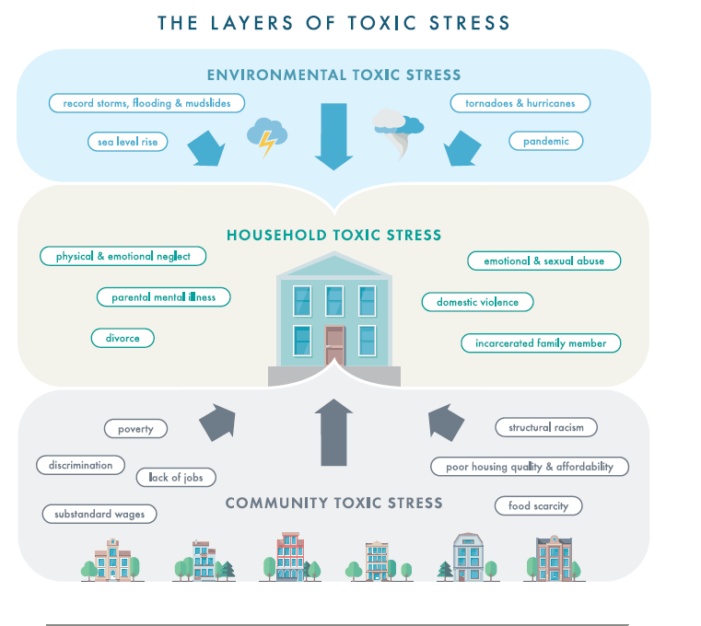
Cumberland County Public Health
Prevention
Held key informant interviews with people across Cumberland County who are working with young people & families that have been impacted by SUD and OUD, to develop a prevention/early intervention strategy for youth.
Listened to advocates for youth on how to create better systems of support
What we’ve learned:
>No focused outreach to young people/families who lost a parent to overdose or incarceration
>Serious lack of tiered systems of support for young people and families impacted by SUD
>Schools and providers overwhelmed with BH needs
>More than 2500 “disconnected young people” in Cumb Co

Slide 14
Cumberland County Public Health:
Coordinated Rapid Response Pilot Idea
Coordinator
Supports coordination among the network of RJ, Youth Serving Orgs, behavioral health programs, & Out of school time programs in Cumberland County
Understands available resources (basic needs and BH) for young people & families
Assesses and collects gaps from young people, orgs, and navigators
Helps build capacity of orgs to fill gaps
Organizes training for the network as needed
Provides individual and group support to navigators
Coordinator
Youth Navigator
Youth Navigator
Youth Navigator
Network of Youth Orgs, RJ, OOST, BH programs
Youth Navigators
Imbedded in schools and community based orgs
Takes referrals from school, families, police, & community based organizations
Quickly builds understanding of young person’s goals and needs
Connects with families if possible
Provides warm handoffs to other orgs and resources that match goals/needs
Possible Funding Sources:
Local Opioid Settlement funds
Dept. of Justice
SAMHSA
CDC
Local Philanthropy

Slide 15
Questions and Comments
Liz Blackwell-Moore
Blackwell-moore@cumberlandcounty.org
207-749-5251

